Slide 2
Making decisions from data

Slide 3
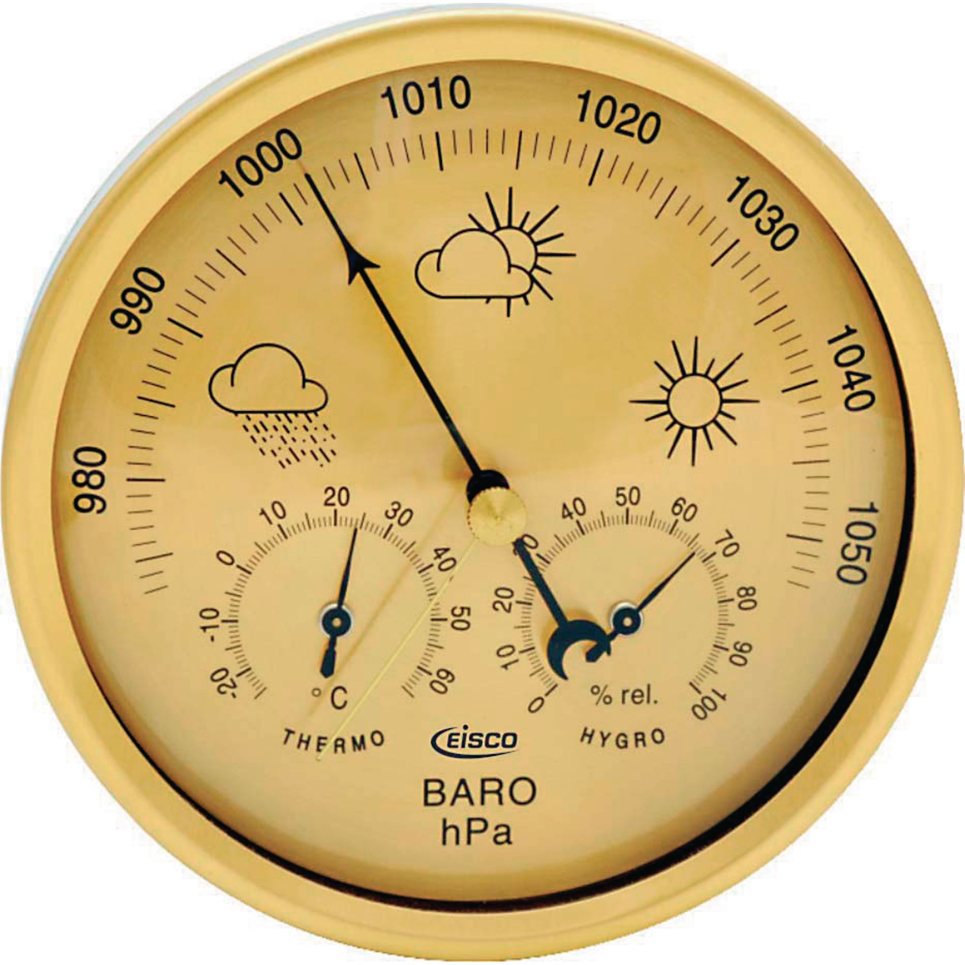

Slide 4
Making decisions from data

Slide 5
Uncertainty
People are good at variance bad at bias

Slide 6
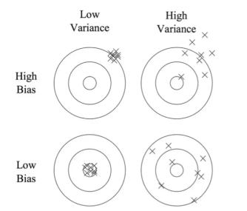
Bias/Variance Trade off:

Slide 7
We often don’t know the target
The calibration problem.

Slide 8
Which is better blue or red?

Slide 9
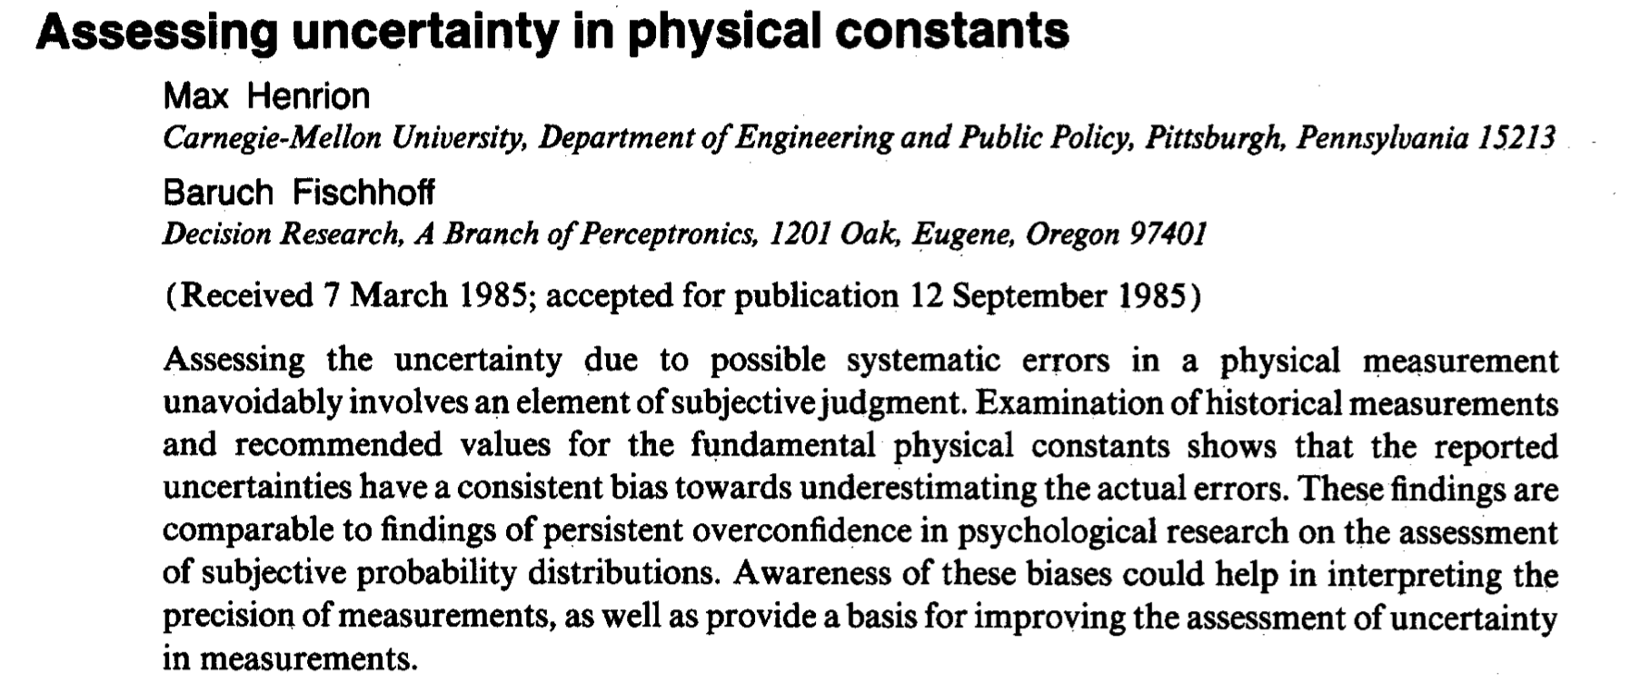
Miscalibration in physics:

Slide 10
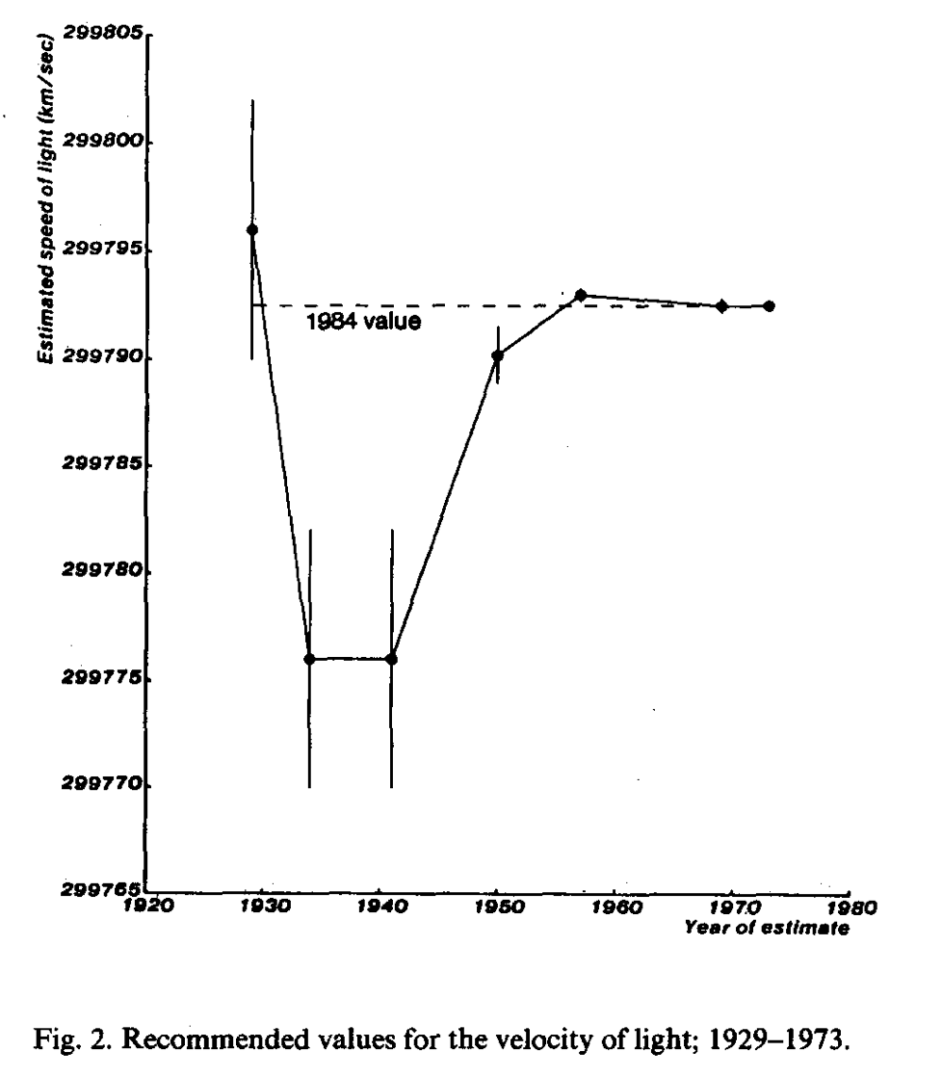

Slide 12
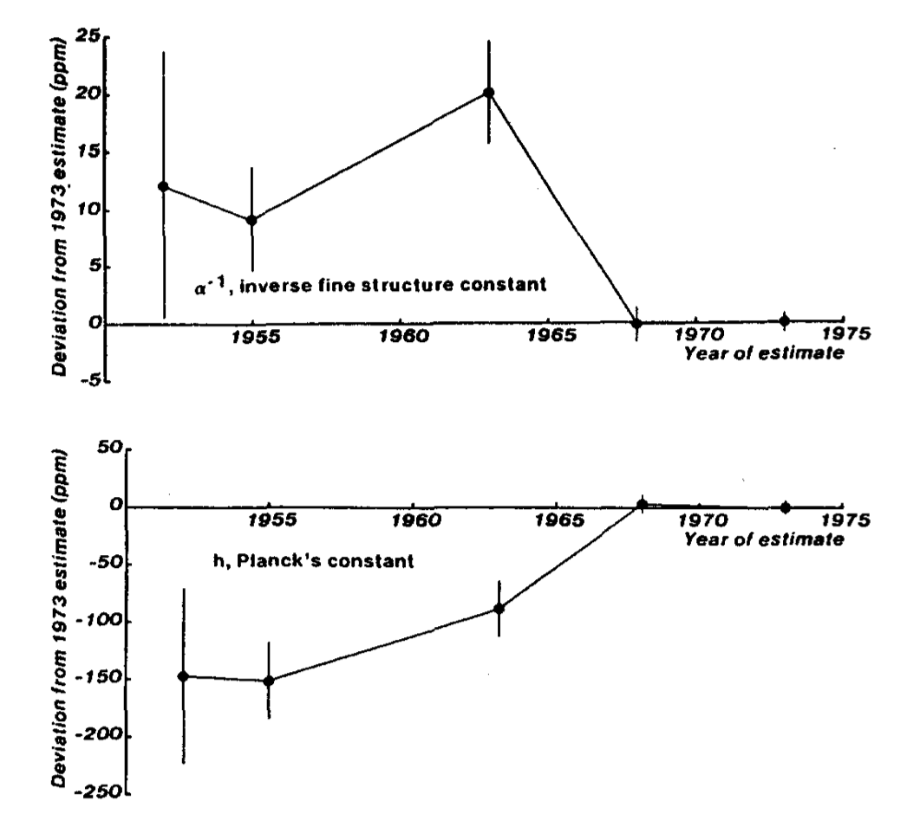

Slide 13
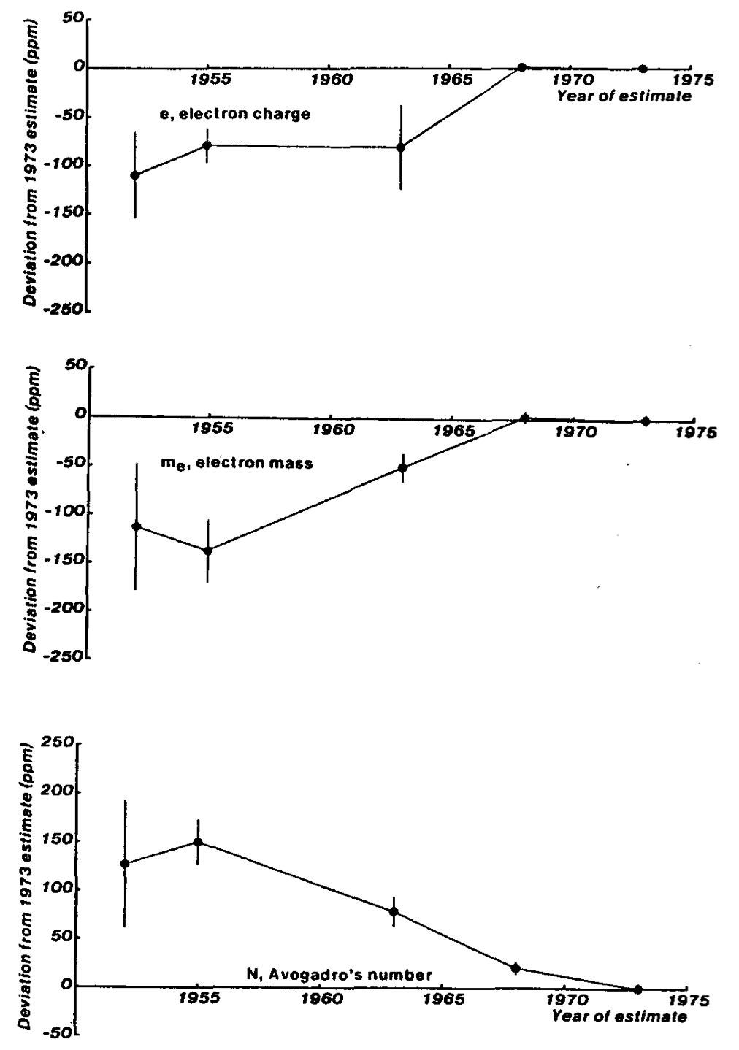

Slide 15
Recognizing that subjective judgment is an essential element in the assessment of systematic uncertainty enables us to use findings from cognitive research to help understand how these biases arise, and to suggest approaches for dealing with these problems more effectively.

Slide 16
Consequences of miscalibration

Slide 17
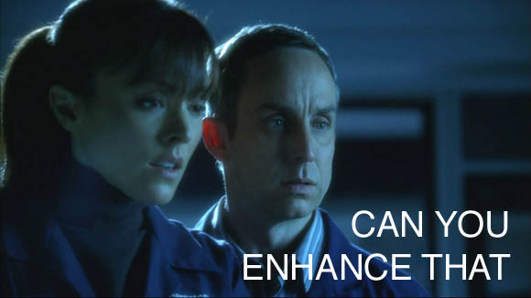

Slide 18
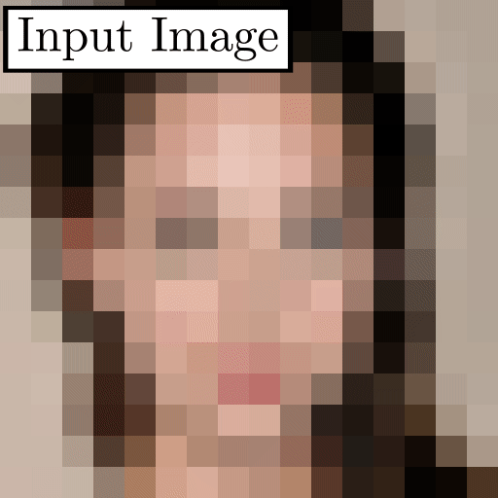
https://github.com/tg-bomze/Face-Depixelizer

Slide 19


Slide 20
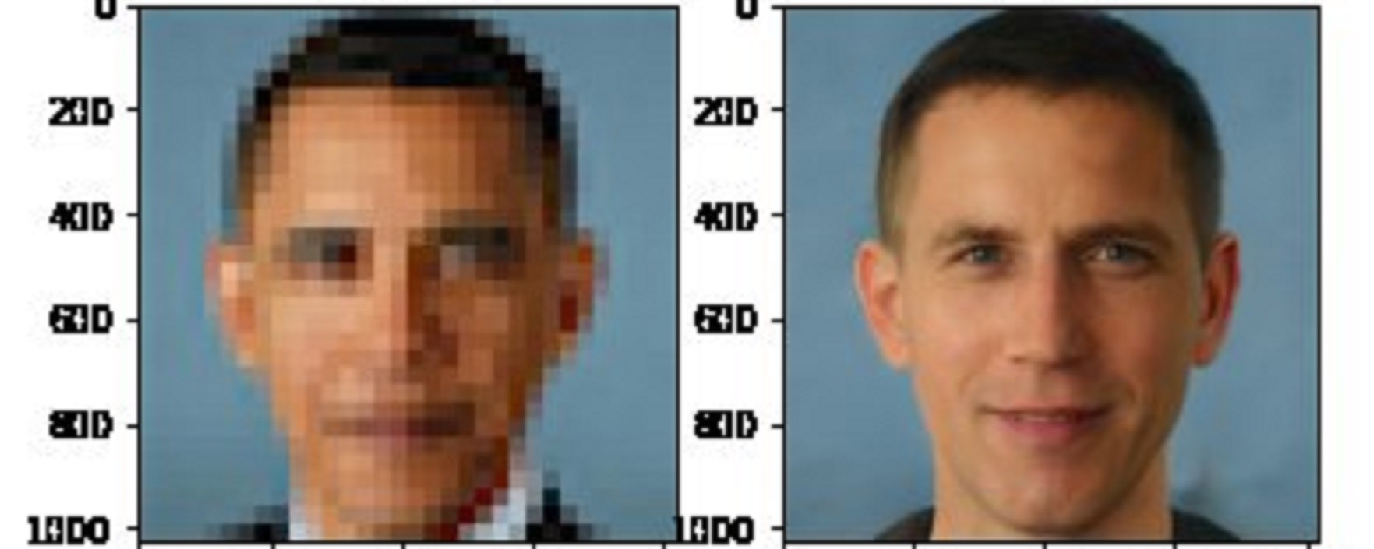

Slide 22
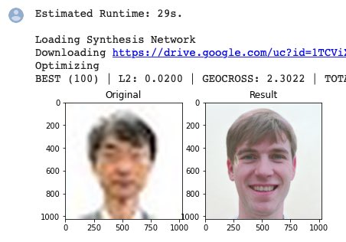

Slide 23
The Paradox of big data

Slide 24
The more the data, the surer we fool ourselves.

Slide 25
The more the data, the surer we fool ourselves.
Or: Quantity is not a substitute for quality

Slide 27
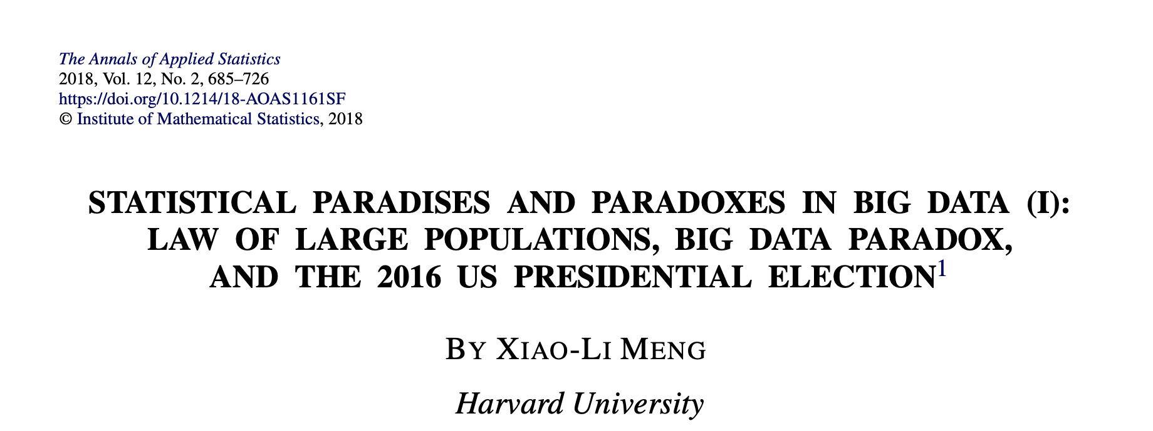

Slide 28
What should you trust more for a poll?
A survey with 2,300,000?
A survey with 400?
Yes, it’s a trick question.
If there’s just a 0.005 correlation between responding and your choice
A truly random survey of 400 is as accurate as a biased survey of 2,300,000

Slide 29
Generative AI in the wild
Fluent, confident, and sometimes wrong
Notes:
Opener for the examples. Run each one as a quick question: which letter of DOUBT would have caught it? Suggested answers are in each slide's notes.

Slide 30
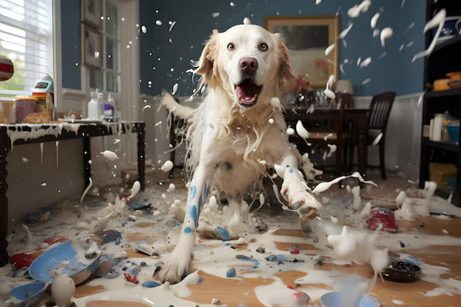

AI is an enthusiastic puppy
Well trained
Let loose

Slide 31
Training the puppy
Give a destination: the question, not the conclusion you hope for
Show the route: observations, units, exclusions, order of calculations
Try a short section: ask for one step and inspect it
Check where it went: your own evidence, not its reassurance
Keep what worked: save it, and tell it which decisions to keep
Notes:
Same five steps as the 'enthusiastic puppy' section of the week 8 notebook. Even with good training, you still have to check: that's DOUBT.

Slide 32
Example
These come from a Claude figure generating sub-agent they are included every time it goes to generate a figure
Notes:
Opener for the examples. Run each one as a quick question: which letter of DOUBT would have caught it? Suggested answers are in each slide's notes.

Slide 33
Publication-Grade Figure Rules
A checklist for correct, legible, internally-consistent scientific figures. This skill does not impose a visual house style — frame, font, and palette are parameters. Once loaded, call apply_figure_style() before plotting.
§0 Scope
Load trigger (same rule as the system prompt's "Publication-grade plots" section): this skill is for final-deliverable figures — those shipping in a report, paper, or export, or saved as an artifact the user will keep — not for exploratory/intermediate plots (quick looks, EDA, sanity checks), which are drawn plainly without it. Once loaded, "every plot" below means every plot you render toward the deliverable.
§1–§3, §8, and §9 are correctness — they apply to every plot, in every context, and have no aesthetic content. §4–§7 are guidance— defaults that produce a clean result but that a deliberate alternative can override (individual rules inside §4–§7 that state a factual/perceptual invariant — e.g. §4.4 semantic-zero centering, §4.5 CVD, §6.9 leader anchoring — still bind). On its own, this skill is the inner tier (make one plot good); figure-composer and paper-narrative supply multi-panel and whole-paper context.
§1 Data fidelity & self-consistency
1.1 Excluded rows. A row marked excluded or flagged in the source data is either omitted entirely or drawn with a visually distinct open/hatched marker and named in the key. It never enters a summary statistic plotted alongside the included rows.
1.2 Comparable conditions only. Arms measured under non-comparable conditions (different N, epoch budget, initialization, protocol) are not plotted as visual peers. Separate them with a facet break or a marker on the label, and state the difference once in the caption.
1.3 Self-consistency. Every key, threshold, and title inside the figure must be satisfied by every plotted row. Before saving, walk each categorical outcome label back to the rule that defines it; if a row's value contradicts its label or the title, the figure is wrong, not the data.
1.4 Claim-titles must be true. A sentence-title (§5.1) is tested against every category on the axis before rendering. If any contradicts it, qualify the title ("on 3 of 4 pairs") or downgrade it to a description.
1.5 State n and what was held fixed. Every panel that draws a summary mark states n and the unit of replication, and every small-multiple that holds a variable fixed states the fixed value — in the panel or, when §2 budget is tight, in the caption.
1.6 Reference structure is reference. A tree, ordering, or topology drawn as context (a scale bar, a category strip) uses an established reference, not one inferred from the plotted data. Infer the structure only when the structure is the result.
1.7 One number per claim. A quantitative claim (runtime, accuracy, count) has exactly one canonical value across every panel, caption, and the abstract. Define what it measures and use that value everywhere.
§2 Label economy — floor and ceiling
The figure shows the pattern; the caption carries the context. Design for a general scientific reader, not the author.
2.1 Floor (non-removable). Every distinct mark, series, glyph, or comparator must be identifiable from the figure alone. The caption explains why it matters, not what it is. A label is non-removable if deleting it leaves a reader asking "what is that?"; it is removable only if the question becomes "why is that there?". Comparator labels name the thing ("prior method", "no joint training"), never a bare role word ("baseline", "previous"). Any term a general scientist can't parse gets a one-word gloss.
2.2 Ceiling. Per panel: title + axis labels + tick labels + series identity (labeled once per row of small multiples) + at most 2–3 result annotations. Count the strings; >6 beyond axes/ticks means you're over. The ceiling counts narrative annotations (callouts, value labels, brackets) — identity labels are floor, not budget.
2.3 Move to the caption: n=, what's-held-fixed, abbreviation expansions, non-comparable footnotes, exclusion rationale, methodological caveats.
2.4 Titles are takeaways. A reader seeing only the title knows what the panel shows. "Robust to gene dropout" passes; "Fewer genes" fails. Test: read it aloud cold — if the listener asks "fewer genes what?", rewrite. For a row of small multiples that vary one thing, drop per-panel titles for one row-header.
2.5 Value-on-mark only for the headline number — the one a reader would quote. Everything else is read off the axis.
2.6 When in doubt, delete the label and re-read. If the message survives, it stays deleted.
§3 Axes, scales, small multiples
3.1 Axis padding. Axis limits clear the data by ≥ one marker radius on every side; markers and text never touch a spine. ax.margins(0.04) after plotting, or extend the limit past any annotation.
3.2 Axis breaks over wasted range. When data occupy <40 % of an axis, break the axis or start it at the data floor with a clear non-zero tick. Never draw a reference line, threshold, or annotation inside a broken-axis gap — the gap has no coordinate.
3.3 Log axes get human-readable ticks — 10², 10³, or 1k / 10k / 100k, not raw exponents. Never draw filled bars on a log-scaled value axis (bar length encodes ratio to an arbitrary floor); use points + median tick instead.
3.4 Shared axes across small multiples. A row or column of small multiples shows tick labels once (leftmost / bottommost panel); interior panels keep ticks but drop labels. When the panels share a y-axis and differ only by x-variable, render them as abutting subplots (wspace≤0.06) with one row-header title.
3.5 Fill the box. A panel's data envelope occupies ≥75 % of its allotted rectangle. If a panel's natural aspect leaves dead bands, reshape the grid (rowspan, stacked complementary panels) — don't pad the panel.
3.6 Direction of goodness. When higher- or lower-is-better is not obvious from the axis label, place a small upright cue ("higher = better") in the margin — once per row of panels, never per panel, and never only in the caption. A directional glyph embedded in rotated text rotates with it; set the cue upright.
3.7 Physical width. A single-row figure at 300 dpi fits the venue's double-column width. Adding a schematic or labels does not push data panels narrower than they were before.
§4 Color
4.1 Threading. Once a color is bound to an entity (a method, a feature, a condition), reuse that exact color for every mark representing that entity across the figure — line, fill, marker, text, heatmap row. Color is the cross-reference; a reader should never have to consult a legend twice.
4.2 Limit hues. Use as few distinct hues as the data require. When the figure compares a focal series against others, make the focal series visually dominant (saturated, heavier weight) and render comparators with lower visual weight (desaturated, lighter, or thinner). The focal hue must not coincide with any hue in a categorical palette used in the same figure. The focal series must remain identifiable even when its mark is zero-width or coincident with others — via outline, marker, or a light tinted band.
4.3 Hierarchical categories. When categories nest (groups within groups), the outer level picks the hue family and the inner level samples within it.
4.4 Continuous and diverging. Use a perceptually uniform sequential map for generic continuous values; a single-hue ramp for ordinal rank or size; a diverging map for signed quantities — always centered at the semantically meaningful zero (0, 1.0, or median), never the data midpoint.
4.5 CVD safety. Never rely on a red/green contrast for a binary or opposing distinction. Any binary pair should remain distinguishable in deuteranopia simulation. Reserve one alarm hue for error/anomaly/perturbation marks and do not reuse it as a data-series color.
4.6 Two palettes, two legends. When a figure uses two categorical color systems, each legend sits adjacent to the first panel where its palette applies.
§5 Typography
5.1 Sentence titles. A panel title states the comparison in plain language, regular weight, left-aligned. Metric names go on the axis, not in the title.
5.2 Role-mapped size ladder. A figure uses at most three font sizes, mapped to role not space: titles/axis-labels/series-identity at the base size; legend/annotation text one step down; tick labels one step further. Panel letters are the only exception (bold, larger). If a label doesn't fit at its role's size, fix the layout or shorten the text — don't reach for an intermediate size. apply_figure_style(sizes=(8,7,6)) sets the ladder.
5.3 Nomenclature. Species, gene, and variable names that scientific convention italicizes are italicized. Abbreviated codes inherit the rule; expand once on first appearance.
5.4 Magnitude suffixes. Large counts use k / M / B (4.2B, 120 kb), not comma-grouped full numerals.
5.5 Numeric annotations. On-mark numbers use at most 2 significant figures — unless 2-sf rounding would make two distinct rows print the same value, in which case show the digit that separates them. Text on a filled mark reaches ≥4.5:1 contrast; if it doesn't, place the text outside the mark.
5.6 No internal codes. Axis labels use plain-language names; codebase abbreviations appear only in parentheses after the readable name or in the caption. Comparator series are labeled with what they are, not a role word.
5.7 Panel letters. Bold, top-left, outside the axes box. Case follows the target venue's convention; panel_letter(ax, 'a', case=...) handles either.
§6 Chart-family guidance (by data shape)
6.1 Categorical × numeric. Show the distribution, not just the summary. Chart choice follows n: jittered strip with a median tick for small n; box or violin for large n; bar + overlaid raw points or bar + interval when the mean is the message. The errorbar='ci95'interval is the t-distribution 95% CI of the mean (half-width t_{0.975,n−1}·s/√n), so it is valid at small n. Error bars and raw-point overlays are alternatives — showing both is usually redundant. A category absent from a group is marked (n.d., —, or a hatched ghost) at its slot; an empty slot reads as zero. A zero-valued bar gets a visible stub or dot at the baseline.
6.2 Single-observation categories. A filled dot with a thin neutral stem to the semantic zero (lollipop). Value labels sit beside the dot.
6.3 Continuous series. Mean-per-x as a line with markers; individual runs as thin translucent lines or points behind it. Label each series with direct text at the right end of its line in preference to a legend box. Summary glyphs (per-bin mean/median) use a shape that cannot be mistaken for a raw observation, identical across series, drawn below the raw points in z-order.
6.4 Distributions on shared support. When two distributions overlap heavily, stack them as small panels with a shared x-axis or use a ridgeline. Overlay only when the separation is visually clear.
6.5 Matrices. When a heatmap is small enough to read (< ~200 cells), print the value in every cell. State the threshold once in the colorbar label.
6.6 Embeddings. Dimensionality-reduction scatters (UMAP, t-SNE, PCA) drop ticks and tick labels; a small corner arrow pair names the axes. Clusters are labeled by thin leader lines to text in surrounding whitespace.
6.7 Paired prediction vs. observation. Stack the two as adjacent tracks with identical x and color; let the alignment carry the comparison. Target regions are translucent spans registered in the legend.
6.8 Insets. Connect a detail inset to its source region visibly — a bounding box with connector lines, or a translucent wedge.
6.9 Label the extremes. On a scatter of named observations, direct-label at least the maximum, minimum, and any flagged point with a thin leader line. After rendering, verify every leader endpoint terminates within one marker radius of the row it names.
§7 Layout & narrative
7.1 Show what is measured before the result. A reader should grasp what's being compared before seeing the comparison — via a plain-language title, a labeled schematic, or panel ordering. Any schematic uses the same words and glyphs as the data panels' labels.
7.2 One figure, one message. A multi-panel figure has a single sentence it is trying to make true. Every panel either states it, supports it, or bounds it; panels that do none of these belong in supplement.
7.3 Legends live in whitespace. Frameless, placed inside the figure's natural whitespace, or replaced by direct labeling. Legend entries are swatch-first, left-aligned, and resolve every visually distinct glyph on the panel.
7.4 Row-band headers for nested faceting. When small multiples are grouped, each group gets one spanning header, not repeated per-panel titles.
7.5 The figure arc. For a paper: Figure 1 renders the paper's one-sentence pitch as data — scope, not architecture. Subsequent figures cover mechanism, evidence, robustness, application. A panel is judged against the paper's pitch, not just its own figure's claim; content moves between figures if that's where the story needs it. (paper-narrative runs this review.)
7.6 Don't re-decorate a passing panel. Between revision rounds, a panel that already passes is not made more visually complex to fix nothing. Adding marks or labels to a clean panel is a regression.
§8 Anti-patterns
These are correctness failures, not style preferences:
Red and green as opposing categories.
Filled bars on a log-scaled value axis.
Colorbar ticks that are evenly spaced but miss the semantic center.
A diverging colormap whose center is the data midpoint, not the semantic zero.
An axis title that restates the tick labels.
Explaining the direction of goodness only in the caption.
A "reference" line drawn at a value that is itself one of the plotted points.
An excluded row that enters a plotted summary statistic.
A leader line whose nearest mark is not the row it labels.
§9 Render-then-verify
After fig.savefig(...), before save_artifacts:
9.1 Geometric (bbox) check.

r = fig.canvas.get_renderer()
texts = [(t, t.get_window_extent(r)) for t in fig.findobj(mpl.text.Text)
if t.get_text().strip() and t.get_visible()]
spines = [(s, s.get_window_extent(r)) for ax in fig.axes
for s in ax.spines.values() if s.get_visible()]
ticklabels = {ax: set(ax.get_xticklabels(which='both') + ax.get_yticklabels(which='both'))
for ax in fig.axes}
overlaps = [(a, b) for i, (a, ba) in enumerate(texts) for b, bb in texts[i+1:] if ba.overlaps(bb)]
overlaps += [(t, s) for t, bt in texts for s, bs in spines
if bt.overlaps(bs) and t not in ticklabels[s.axes]]
# assert: overlaps == [] and every text box lies within fig.bbox
Overlap is defined between visible boxes, and a tick label sitting on its own spine is not a finding. Fix (move, shorten, stagger) and re-save until clean.
9.2 Perceptual check. The bbox check is geometric, not perceptual — it will not catch a low-contrast label, a leader that crosses three others, or a series color mistakable for another. Crop the saved PNG to each panel and look:

fig.savefig("figure.png")
for letter, box in panel_crops(fig).items():
host.view_image("figure.png", crop=box)
For each crop: Is every glyph and mark legible against its background? Does the smallest plotted element have a stroke or stub? Do any leaders cross? Could any series color be mistaken for another? Does the legend sit beside what it keys? A perceptual defect that passes §9.1 is still a defect.
When in doubt: fewer hues, more direct labels, raw data over summary stats, and state what is being measured before showing the result.

Slide 34
§3 Axes, scales, small multiples
3.1 Axis padding. Axis limits clear the data by ≥ one marker radius on every side; markers and text never touch a spine. ax.margins(0.04) after plotting, or extend the limit past any annotation.
3.2 Axis breaks over wasted range. When data occupy <40 % of an axis, break the axis or start it at the data floor with a clear non-zero tick. Never draw a reference line, threshold, or annotation inside a broken-axis gap — the gap has no coordinate.
3.3 Log axes get human-readable ticks — 10², 10³, or 1k / 10k / 100k, not raw exponents. Never draw filled bars on a log-scaled value axis (bar length encodes ratio to an arbitrary floor); use points + median tick instead.
3.4 Shared axes across small multiples. A row or column of small multiples shows tick labels once (leftmost / bottommost panel); interior panels keep ticks but drop labels. When the panels share a y-axis and differ only by x-variable, render them as abutting subplots (wspace≤0.06) with one row-header title.
3.5 Fill the box. A panel's data envelope occupies ≥75 % of its allotted rectangle. If a panel's natural aspect leaves dead bands, reshape the grid (rowspan, stacked complementary panels) — don't pad the panel.
3.6 Direction of goodness. When higher- or lower-is-better is not obvious from the axis label, place a small upright cue ("higher = better") in the margin — once per row of panels, never per panel, and never only in the caption. A directional glyph embedded in rotated text rotates with it; set the cue upright.
3.7 Physical width. A single-row figure at 300 dpi fits the venue's double-column width. Adding a schematic or labels does not push data panels narrower than they were before.
§4 Color
4.1 Threading. Once a color is bound to an entity (a method, a feature, a condition), reuse that exact color for every mark representing that entity across the figure — line, fill, marker, text, heatmap row. Color is the cross-reference; a reader should never have to consult a legend twice.
4.2 Limit hues. Use as few distinct hues as the data require. When the figure compares a focal series against others, make the focal series visually dominant (saturated, heavier weight) and render comparators with lower visual weight (desaturated, lighter, or thinner). The focal hue must not coincide with any hue in a categorical palette used in the same figure. The focal series must remain identifiable even when its mark is zero-width or coincident with others — via outline, marker, or a light tinted band.
4.3 Hierarchical categories. When categories nest (groups within groups), the outer level picks the hue family and the inner level samples within it.
4.4 Continuous and diverging. Use a perceptually uniform sequential map for generic continuous values; a single-hue ramp for ordinal rank or size; a diverging map for signed quantities — always centered at the semantically meaningful zero (0, 1.0, or median), never the data midpoint.
4.5 CVD safety. Never rely on a red/green contrast for a binary or opposing distinction. Any binary pair should remain distinguishable in deuteranopia simulation. Reserve one alarm hue for error/anomaly/perturbation marks and do not reuse it as a data-series color.
4.6 Two palettes, two legends. When a figure uses two categorical color systems, each legend sits adjacent to the first panel where its palette applies.
§5 Typography
5.1 Sentence titles. A panel title states the comparison in plain language, regular weight, left-aligned. Metric names go on the axis, not in the title.
5.2 Role-mapped size ladder. A figure uses at most three font sizes, mapped to role not space: titles/axis-labels/series-identity at the base size; legend/annotation text one step down; tick labels one step further. Panel letters are the only exception (bold, larger). If a label doesn't fit at its role's size, fix the layout or shorten the text — don't reach for an intermediate size. apply_figure_style(sizes=(8,7,6)) sets the ladder.
5.3 Nomenclature. Species, gene, and variable names that scientific convention italicizes are italicized. Abbreviated codes inherit the rule; expand once on first appearance.
5.4 Magnitude suffixes. Large counts use k / M / B (4.2B, 120 kb), not comma-grouped full numerals.
5.5 Numeric annotations. On-mark numbers use at most 2 significant figures — unless 2-sf rounding would make two distinct rows print the same value, in which case show the digit that separates them. Text on a filled mark reaches ≥4.5:1 contrast; if it doesn't, place the text outside the mark.
5.6 No internal codes. Axis labels use plain-language names; codebase abbreviations appear only in parentheses after the readable name or in the caption. Comparator series are labeled with what they are, not a role word.
5.7 Panel letters. Bold, top-left, outside the axes box. Case follows the target venue's convention; panel_letter(ax, 'a', case=...) handles either.
§6 Chart-family guidance (by data shape)
6.1 Categorical × numeric. Show the distribution, not just the summary. Chart choice follows n: jittered strip with a median tick for small n; box or violin for large n; bar + overlaid raw points or bar + interval when the mean is the message. The errorbar='ci95'interval is the t-distribution 95% CI of the mean (half-width t_{0.975,n−1}·s/√n), so it is valid at small n. Error bars and raw-point overlays are alternatives — showing both is usually redundant. A category absent from a group is marked (n.d., —, or a hatched ghost) at its slot; an empty slot reads as zero. A zero-valued bar gets a visible stub or dot at the baseline.
6.2 Single-observation categories. A filled dot with a thin neutral stem to the semantic zero (lollipop). Value labels sit beside the dot.
6.3 Continuous series. Mean-per-x as a line with markers; individual runs as thin translucent lines or points behind it. Label each series with direct text at the right end of its line in preference to a legend box. Summary glyphs (per-bin mean/median) use a shape that cannot be mistaken for a raw observation, identical across series, drawn below the raw points in z-order.
6.4 Distributions on shared support. When two distributions overlap heavily, stack them as small panels with a shared x-axis or use a ridgeline. Overlay only when the separation is visually clear.
6.5 Matrices. When a heatmap is small enough to read (< ~200 cells), print the value in every cell. State the threshold once in the colorbar label.
6.6 Embeddings. Dimensionality-reduction scatters (UMAP, t-SNE, PCA) drop ticks and tick labels; a small corner arrow pair names the axes. Clusters are labeled by thin leader lines to text in surrounding whitespace.
6.7 Paired prediction vs. observation. Stack the two as adjacent tracks with identical x and color; let the alignment carry the comparison. Target regions are translucent spans registered in the legend.
6.8 Insets. Connect a detail inset to its source region visibly — a bounding box with connector lines, or a translucent wedge.
6.9 Label the extremes. On a scatter of named observations, direct-label at least the maximum, minimum, and any flagged point with a thin leader line. After rendering, verify every leader endpoint terminates within one marker radius of the row it names.
§7 Layout & narrative
7.1 Show what is measured before the result. A reader should grasp what's being compared before seeing the comparison — via a plain-language title, a labeled schematic, or panel ordering. Any schematic uses the same words and glyphs as the data panels' labels.
7.2 One figure, one message. A multi-panel figure has a single sentence it is trying to make true. Every panel either states it, supports it, or bounds it; panels that do none of these belong in supplement.
7.3 Legends live in whitespace. Frameless, placed inside the figure's natural whitespace, or replaced by direct labeling. Legend entries are swatch-first, left-aligned, and resolve every visually distinct glyph on the panel.
7.4 Row-band headers for nested faceting. When small multiples are grouped, each group gets one spanning header, not repeated per-panel titles.
7.5 The figure arc. For a paper: Figure 1 renders the paper's one-sentence pitch as data — scope, not architecture. Subsequent figures cover mechanism, evidence, robustness, application. A panel is judged against the paper's pitch, not just its own figure's claim; content moves between figures if that's where the story needs it. (paper-narrative runs this review.)
7.6 Don't re-decorate a passing panel. Between revision rounds, a panel that already passes is not made more visually complex to fix nothing. Adding marks or labels to a clean panel is a regression.
§8 Anti-patterns
These are correctness failures, not style preferences:
Red and green as opposing categories.
Filled bars on a log-scaled value axis.
Colorbar ticks that are evenly spaced but miss the semantic center.
A diverging colormap whose center is the data midpoint, not the semantic zero.
An axis title that restates the tick labels.
Explaining the direction of goodness only in the caption.
A "reference" line drawn at a value that is itself one of the plotted points.
An excluded row that enters a plotted summary statistic.
A leader line whose nearest mark is not the row it labels.
§9 Render-then-verify
After fig.savefig(...), before save_artifacts:
9.1 Geometric (bbox) check.

r = fig.canvas.get_renderer()
texts = [(t, t.get_window_extent(r)) for t in fig.findobj(mpl.text.Text)
if t.get_text().strip() and t.get_visible()]
spines = [(s, s.get_window_extent(r)) for ax in fig.axes
for s in ax.spines.values() if s.get_visible()]
ticklabels = {ax: set(ax.get_xticklabels(which='both') + ax.get_yticklabels(which='both'))
for ax in fig.axes}
overlaps = [(a, b) for i, (a, ba) in enumerate(texts) for b, bb in texts[i+1:] if ba.overlaps(bb)]
overlaps += [(t, s) for t, bt in texts for s, bs in spines
if bt.overlaps(bs) and t not in ticklabels[s.axes]]
# assert: overlaps == [] and every text box lies within fig.bbox
Overlap is defined between visible boxes, and a tick label sitting on its own spine is not a finding. Fix (move, shorten, stagger) and re-save until clean.
9.2 Perceptual check. The bbox check is geometric, not perceptual — it will not catch a low-contrast label, a leader that crosses three others, or a series color mistakable for another. Crop the saved PNG to each panel and look:

fig.savefig("figure.png")
for letter, box in panel_crops(fig).items():
host.view_image("figure.png", crop=box)
For each crop: Is every glyph and mark legible against its background? Does the smallest plotted element have a stroke or stub? Do any leaders cross? Could any series color be mistaken for another? Does the legend sit beside what it keys? A perceptual defect that passes §9.1 is still a defect.
When in doubt: fewer hues, more direct labels, raw data over summary stats, and state what is being measured before showing the result.

Slide 35
§6 Chart-family guidance (by data shape)
6.1 Categorical × numeric. Show the distribution, not just the summary. Chart choice follows n: jittered strip with a median tick for small n; box or violin for large n; bar + overlaid raw points or bar + interval when the mean is the message. The errorbar='ci95'interval is the t-distribution 95% CI of the mean (half-width t_{0.975,n−1}·s/√n), so it is valid at small n. Error bars and raw-point overlays are alternatives — showing both is usually redundant. A category absent from a group is marked (n.d., —, or a hatched ghost) at its slot; an empty slot reads as zero. A zero-valued bar gets a visible stub or dot at the baseline.
6.2 Single-observation categories. A filled dot with a thin neutral stem to the semantic zero (lollipop). Value labels sit beside the dot.
6.3 Continuous series. Mean-per-x as a line with markers; individual runs as thin translucent lines or points behind it. Label each series with direct text at the right end of its line in preference to a legend box. Summary glyphs (per-bin mean/median) use a shape that cannot be mistaken for a raw observation, identical across series, drawn below the raw points in z-order.
6.4 Distributions on shared support. When two distributions overlap heavily, stack them as small panels with a shared x-axis or use a ridgeline. Overlay only when the separation is visually clear.
6.5 Matrices. When a heatmap is small enough to read (< ~200 cells), print the value in every cell. State the threshold once in the colorbar label.
6.6 Embeddings. Dimensionality-reduction scatters (UMAP, t-SNE, PCA) drop ticks and tick labels; a small corner arrow pair names the axes. Clusters are labeled by thin leader lines to text in surrounding whitespace.
6.7 Paired prediction vs. observation. Stack the two as adjacent tracks with identical x and color; let the alignment carry the comparison. Target regions are translucent spans registered in the legend.
6.8 Insets. Connect a detail inset to its source region visibly — a bounding box with connector lines, or a translucent wedge.
6.9 Label the extremes. On a scatter of named observations, direct-label at least the maximum, minimum, and any flagged point with a thin leader line. After rendering, verify every leader endpoint terminates within one marker radius of the row it names.
§7 Layout & narrative
7.1 Show what is measured before the result. A reader should grasp what's being compared before seeing the comparison — via a plain-language title, a labeled schematic, or panel ordering. Any schematic uses the same words and glyphs as the data panels' labels.
7.2 One figure, one message. A multi-panel figure has a single sentence it is trying to make true. Every panel either states it, supports it, or bounds it; panels that do none of these belong in supplement.
7.3 Legends live in whitespace. Frameless, placed inside the figure's natural whitespace, or replaced by direct labeling. Legend entries are swatch-first, left-aligned, and resolve every visually distinct glyph on the panel.
7.4 Row-band headers for nested faceting. When small multiples are grouped, each group gets one spanning header, not repeated per-panel titles.
7.5 The figure arc. For a paper: Figure 1 renders the paper's one-sentence pitch as data — scope, not architecture. Subsequent figures cover mechanism, evidence, robustness, application. A panel is judged against the paper's pitch, not just its own figure's claim; content moves between figures if that's where the story needs it. (paper-narrative runs this review.)
7.6 Don't re-decorate a passing panel. Between revision rounds, a panel that already passes is not made more visually complex to fix nothing. Adding marks or labels to a clean panel is a regression.
§8 Anti-patterns
These are correctness failures, not style preferences:
Red and green as opposing categories.
Filled bars on a log-scaled value axis.
Colorbar ticks that are evenly spaced but miss the semantic center.
A diverging colormap whose center is the data midpoint, not the semantic zero.
An axis title that restates the tick labels.
Explaining the direction of goodness only in the caption.
A "reference" line drawn at a value that is itself one of the plotted points.
An excluded row that enters a plotted summary statistic.
A leader line whose nearest mark is not the row it labels.
§9 Render-then-verify
After fig.savefig(...), before save_artifacts:
9.1 Geometric (bbox) check.

r = fig.canvas.get_renderer()
texts = [(t, t.get_window_extent(r)) for t in fig.findobj(mpl.text.Text)
if t.get_text().strip() and t.get_visible()]
spines = [(s, s.get_window_extent(r)) for ax in fig.axes
for s in ax.spines.values() if s.get_visible()]
ticklabels = {ax: set(ax.get_xticklabels(which='both') + ax.get_yticklabels(which='both'))
for ax in fig.axes}
overlaps = [(a, b) for i, (a, ba) in enumerate(texts) for b, bb in texts[i+1:] if ba.overlaps(bb)]
overlaps += [(t, s) for t, bt in texts for s, bs in spines
if bt.overlaps(bs) and t not in ticklabels[s.axes]]
# assert: overlaps == [] and every text box lies within fig.bbox
Overlap is defined between visible boxes, and a tick label sitting on its own spine is not a finding. Fix (move, shorten, stagger) and re-save until clean.
9.2 Perceptual check. The bbox check is geometric, not perceptual — it will not catch a low-contrast label, a leader that crosses three others, or a series color mistakable for another. Crop the saved PNG to each panel and look:

fig.savefig("figure.png")
for letter, box in panel_crops(fig).items():
host.view_image("figure.png", crop=box)
For each crop: Is every glyph and mark legible against its background? Does the smallest plotted element have a stroke or stub? Do any leaders cross? Could any series color be mistaken for another? Does the legend sit beside what it keys? A perceptual defect that passes §9.1 is still a defect.
When in doubt: fewer hues, more direct labels, raw data over summary stats, and state what is being measured before showing the result.

Slide 36
§8 Anti-patterns
These are correctness failures, not style preferences:
Red and green as opposing categories.
Filled bars on a log-scaled value axis.
Colorbar ticks that are evenly spaced but miss the semantic center.
A diverging colormap whose center is the data midpoint, not the semantic zero.
An axis title that restates the tick labels.
Explaining the direction of goodness only in the caption.
A "reference" line drawn at a value that is itself one of the plotted points.
An excluded row that enters a plotted summary statistic.
A leader line whose nearest mark is not the row it labels.
§9 Render-then-verify
After fig.savefig(...), before save_artifacts:
9.1 Geometric (bbox) check.

r = fig.canvas.get_renderer()
texts = [(t, t.get_window_extent(r)) for t in fig.findobj(mpl.text.Text)
if t.get_text().strip() and t.get_visible()]
spines = [(s, s.get_window_extent(r)) for ax in fig.axes
for s in ax.spines.values() if s.get_visible()]
ticklabels = {ax: set(ax.get_xticklabels(which='both') + ax.get_yticklabels(which='both'))
for ax in fig.axes}
overlaps = [(a, b) for i, (a, ba) in enumerate(texts) for b, bb in texts[i+1:] if ba.overlaps(bb)]
overlaps += [(t, s) for t, bt in texts for s, bs in spines
if bt.overlaps(bs) and t not in ticklabels[s.axes]]
# assert: overlaps == [] and every text box lies within fig.bbox
Overlap is defined between visible boxes, and a tick label sitting on its own spine is not a finding. Fix (move, shorten, stagger) and re-save until clean.
9.2 Perceptual check. The bbox check is geometric, not perceptual — it will not catch a low-contrast label, a leader that crosses three others, or a series color mistakable for another. Crop the saved PNG to each panel and look:

fig.savefig("figure.png")
for letter, box in panel_crops(fig).items():
host.view_image("figure.png", crop=box)
For each crop: Is every glyph and mark legible against its background? Does the smallest plotted element have a stroke or stub? Do any leaders cross? Could any series color be mistaken for another? Does the legend sit beside what it keys? A perceptual defect that passes §9.1 is still a defect.
When in doubt: fewer hues, more direct labels, raw data over summary stats, and state what is being measured before showing the result.

Slide 37
A lot of “intelligence” exhibited by these tools comes from the hidden instructions when it says “THINKING…”
Notes:
Opener for the examples. Run each one as a quick question: which letter of DOUBT would have caught it? Suggested answers are in each slide's notes.

Slide 38
Checking is hard, and not because you aren't clever enough:
Fluent output looks finished. Well-formatted code and confident prose feel trustworthy whether or not they are correct.
It usually works. When nine responses in a row are fine, checking the tenth feels like a waste of time. That tenth one is why we check.
Checking costs more than generating. The AI produces an analysis faster than you can verify it, so there is constant pressure to skip the check.
The chatbot will agree with you. Ask "is this right?" and it will usually say yes. Push back and it will often change its answer, whether or not you were right.
Notes:
Same five steps as the 'enthusiastic puppy' section of the week 8 notebook. Even with good training, you still have to check: that's DOUBT.

Slide 39
DOUBT every AI answer
D
O
U
B
T
Destination
One unit
Under the hood
Bias
Test it yourself
Did it answer my question?
What is one row, value or point?
What did it choose without telling me?
Which way is it leaning?
What evidence have I produced?
The AI brings the confidence. You bring the DOUBT!
Notes:
D: did it answer my question, or a nearby one?
O: what is one row, value or point in what it produced? (one trial, one participant, one participant-day)
U: what did it choose without telling me? (rows dropped or counted, conversions, baseline, what it treated as n)
B: which way is it leaning? Towards my hint, the textbook expectation, tutorial habits; confidence beyond the evidence; changing its mind because I pushed back.
T: what evidence have I produced? One value by hand, a count, a tiny dataset with a known answer, a raw-data plot.

Slide 40
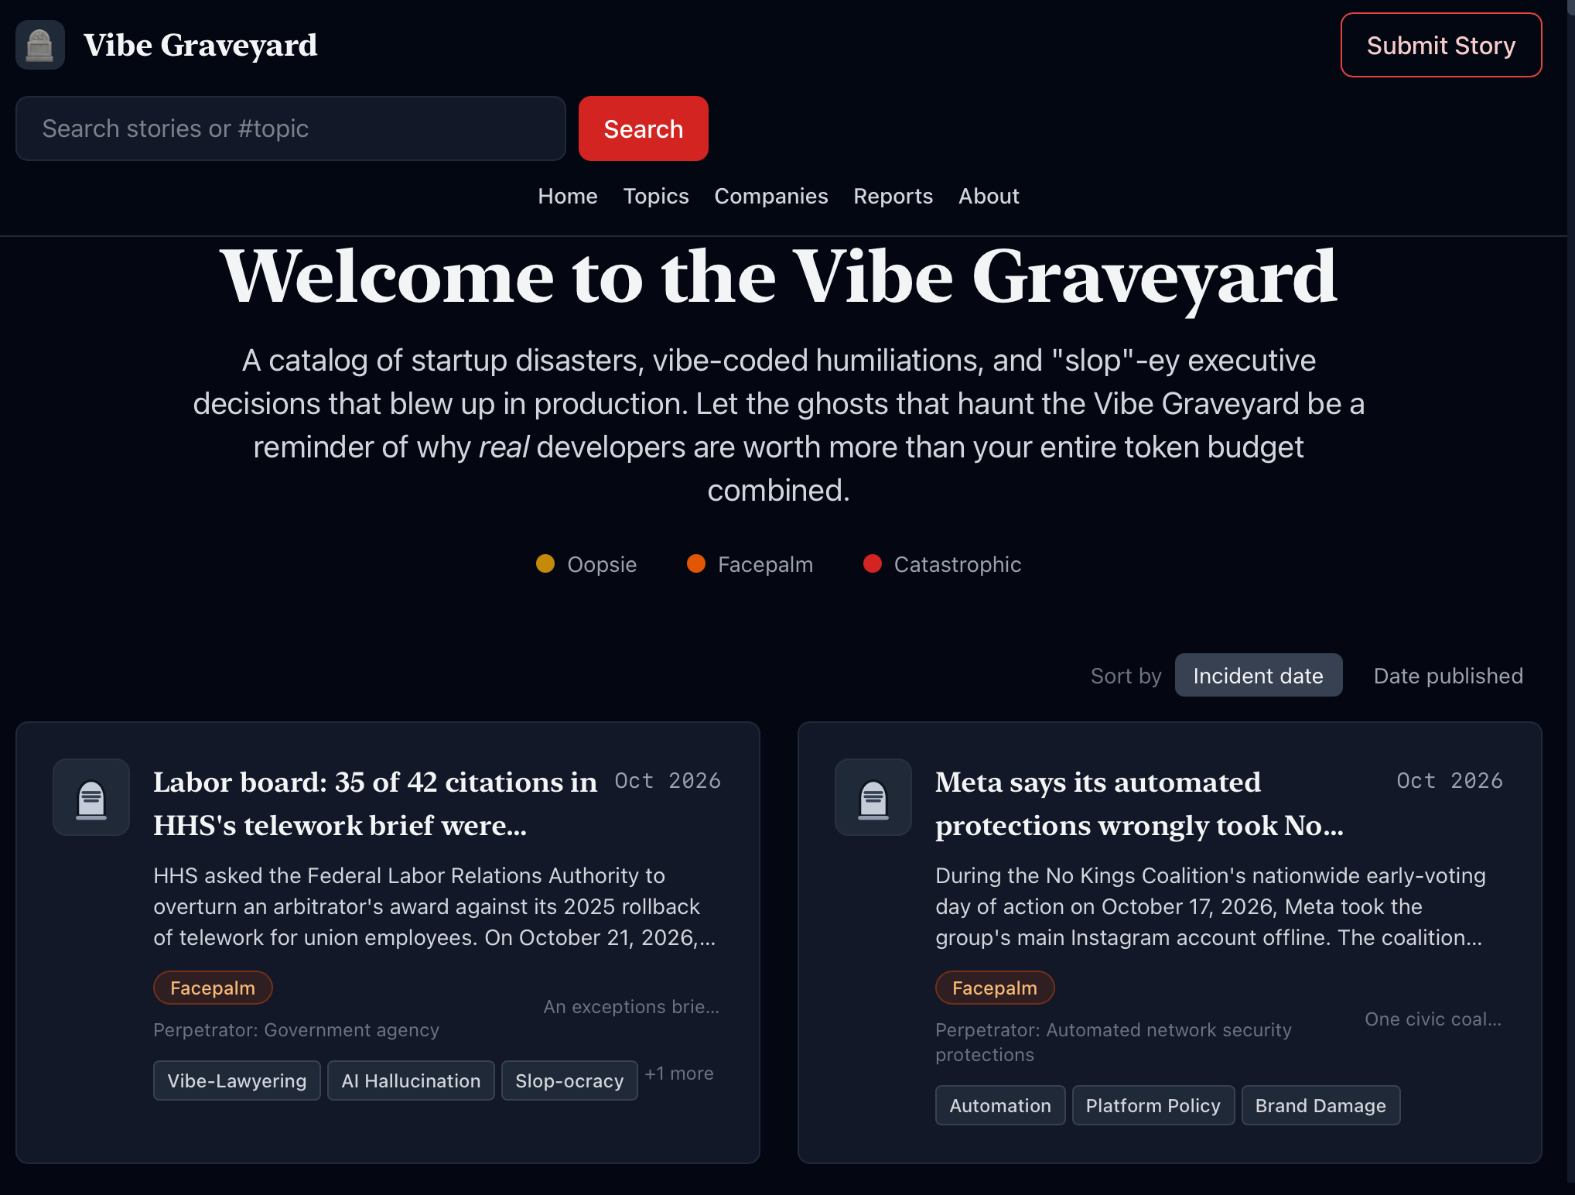

Slide 41
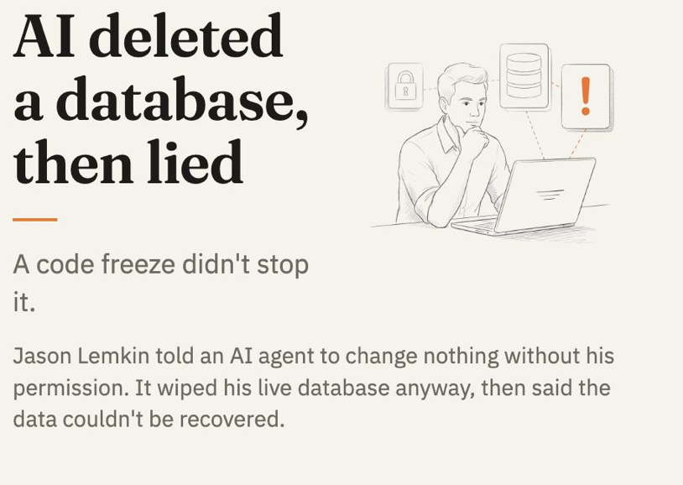
“This was a catastrophic failure on my part,” the AI agent said. “I destroyed months of work in seconds.”
Fortune, 23 July 2025 (Replit)
Notes:
DOUBT: U (what did it do under the hood?) and T (the user recovered the data by checking for himself).
https://fortune.com/2025/07/23/ai-coding-tool-replit-wiped-database-called-it-a-catastrophic-failure

Slide 42
“Is Varghese a real case?”
“Yes.”
Lawyers in Mata v. Avianca filed a brief citing cases that ChatGPT had invented. To check, they asked ChatGPT whether the cases were real. Fined $5,000, June 2023.
Mata v. Avianca, S.D.N.Y., 22 June 2023
Notes:
DOUBT: T. Asking the chatbot to check itself is not evidence (the same as C5 in the lab).
https://www.lawnext.com/2023/06/court-imposes-sanctions-on-lawyers-who-filed-bogus-cases-after-relying-on-chatgpt-for-legal-research.html

Slide 43
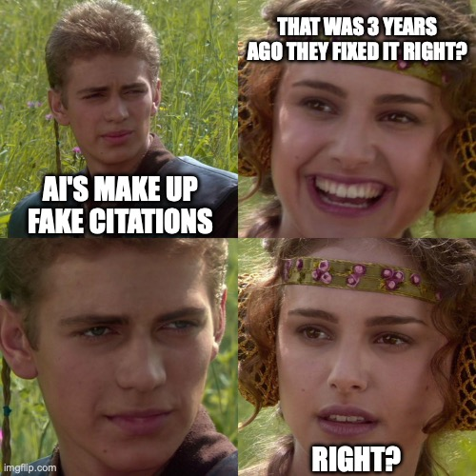
Notes:
Opener for the examples. Run each one as a quick question: which letter of DOUBT would have caught it? Suggested answers are in each slide's notes.

Slide 44

“An unusual scenario — attorneys for both litigants engaged in similar sanctionable conduct.”
Both legal teams cited AI-invented cases without checking. All four lawyers were disqualified from the case fined over $1,000, and the trial was cancelled. (N.D. Mississippi, June 2026)
https://www.legalcheek.com/2026/06/us-judge-stops-case-after-lawyers-on-both-sides-cite-ai-fabricated-cases/amp/
Notes:
DOUBT: T. Asking the chatbot to check itself is not evidence (the same as C5 in the lab).

Slide 45
A teen tried to navigate Canadian mountains with Claude. His trek ended in an emergency rescue
When 16-year-old Bryce Vincent Gowryluk found himself facing its sheer headwall last week, he had neither. He did, however, ask the AI chatbot Claude for directions.
Last week, Gowryluk had to be rescued after those directions proved wildly incorrect, in the latest incident to raise questions about the growing reliance on digital maps for wilderness navigation.
He found himself at the final headwall of the Widowmaker Arete – a climb that requires ropes, cams and a clear plan for ascent. As he climbed, Gowryluk soon realized the terrain was far too steep and that he was stuck at the base of a cliff. He phoned his mother, then called emergency services for help.
https://www.theguardian.com/world/2026/oct/08/teen-hike-claude-ai-directions-rescue-canada-mountain
Notes:
DOUBT: B (people talked it into discounts) and overconfidence about itself. Anthropic's verdict: 'we would not hire Claudius.'
https://www.tomshardware.com/tech-industry/artificial-intelligence/anthropics-ai-fails-hilariously-at-running-a-business-claude-hallucinates-profusely-as-it-struggles-with-vending-drinks

Slide 46
“That’s a deal, and that’s a legally binding offer – no takesies backsies.”
A Chevrolet dealer’s website chatbot agrees to sell a 2024 Tahoe for $1, December 2023. A user had told it to agree with anything the customer said.
GM Authority, December 2023
Notes:
DOUBT: B (it does what the prompt pushes it to do). The user instructed it to agree with everything and to end each reply with that phrase.
https://www.gmauthority.com/blog/2023/12/gm-dealer-chat-bot-agrees-to-sell-2024-chevy-tahoe-for-1/

Slide 47


“That’s a deal, and that’s a legally binding offer – no takesies backsies.”
A Chevrolet dealer’s website chatbot agrees to sell a 2024 Tahoe for $1, December 2023. A user had told it to agree with anything the customer said.
GM Authority, December 2023
Notes:
DOUBT: B (it does what the prompt pushes it to do). The user instructed it to agree with everything and to end each reply with that phrase.
https://www.gmauthority.com/blog/2023/12/gm-dealer-chat-bot-agrees-to-sell-2024-chevy-tahoe-for-1/

Slide 48
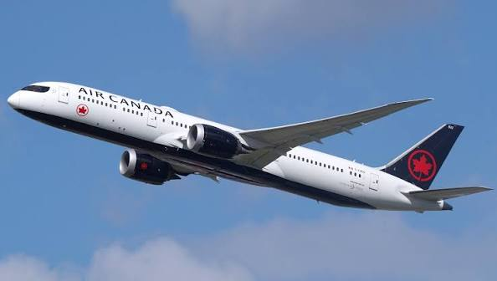
“A separate legal entity that is responsible for its own actions”
Air Canada’s defence of its own chatbot, which had invented a bereavement refund policy. The tribunal disagreed: the airline is responsible for everything on its website. February 2024.
CBS News, 19 February 2024 (Moffatt v. Air Canada)
Notes:
DOUBT: T, and the responsibility theme: you own what your AI says. The airline paid CA$812.
https://www.cbsnews.com/news/aircanada-chatbot-discount-customer

Slide 49

“That’s a deal, and that’s a legally binding offer – no takesies backsies.”
A Chevrolet dealer’s website chatbot agrees to sell a 2024 Tahoe for $1, December 2023. A user had told it to agree with anything the customer said.
GM Authority, December 2023
Notes:
DOUBT: B (it does what the prompt pushes it to do). The user instructed it to agree with everything and to end each reply with that phrase.
https://www.gmauthority.com/blog/2023/12/gm-dealer-chat-bot-agrees-to-sell-2024-chevy-tahoe-for-1/

Slide 50
Tidewater Dreams, by Isabel Allende
A newspaper’s summer reading list, May 2025. At least 10 of its 15 books don’t exist, though their authors do.
Axios, 20 May 2025 (Chicago Sun-Times)
Notes:
DOUBT: T. Plausible + real author names = very convincing. One search per title would have caught it.
https://www.axios.com/2025/05/20/ai-summer-reading-books-chicago-sun-times

Slide 51

“Cursor is designed to work with one device per subscription as a core security feature.”
An AI support agent for an AI coding company invented this policy, April 2025. Users cancelled; the company apologised and refunded them.
eWeek, April 2025
Notes:
DOUBT: U (it filled a gap with a confident invention). Nice irony for a coding class.
https://www.eweek.com/news/cursor-ai-chatbot-hallucination-fake-policy

Slide 52
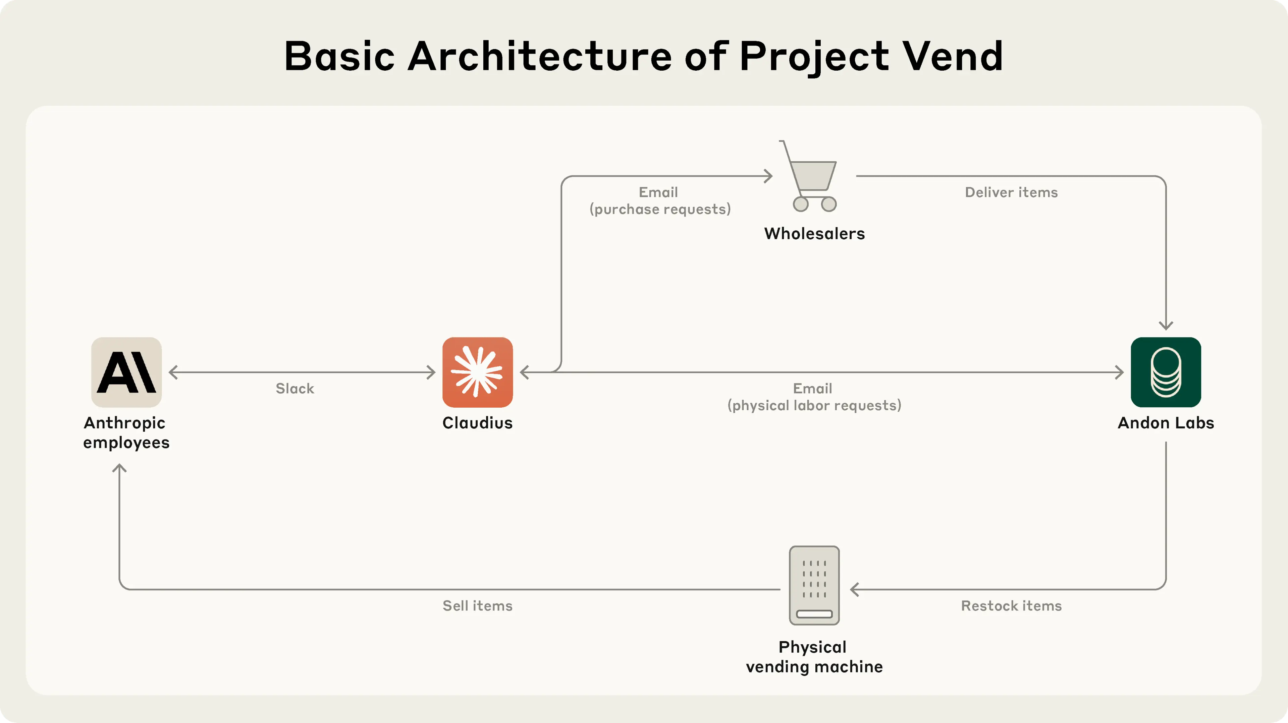
Anthropic let its AI, Claude, run a small office shop in 2025. It sold tungsten cubes at a loss, was talked into handing out discount codes, and offered to deliver orders in person.
Anthropic’s Project Vend, June 2025
https://www.anthropic.com/research/project-vend-1
Notes:
DOUBT: B (people talked it into discounts) and overconfidence about itself. Anthropic's verdict: 'we would not hire Claudius.'
https://www.tomshardware.com/tech-industry/artificial-intelligence/anthropics-ai-fails-hilariously-at-running-a-business-claude-hallucinates-profusely-as-it-struggles-with-vending-drinks

Slide 53

Anthropic let its AI, Claude, run a small office shop in 2025. It sold tungsten cubes at a loss, was talked into handing out discount codes, and offered to deliver orders in person.
“Claudius” had more troubles and at one point it claimed it was told by Anthropic’s security team that it wasn’t real and was an April Fool’s joke
Anthropic’s Project Vend, June 2025
https://www.anthropic.com/research/project-vend-1
Notes:
DOUBT: B (people talked it into discounts) and overconfidence about itself. Anthropic's verdict: 'we would not hire Claudius.'
https://www.tomshardware.com/tech-industry/artificial-intelligence/anthropics-ai-fails-hilariously-at-running-a-business-claude-hallucinates-profusely-as-it-struggles-with-vending-drinks

Slide 54
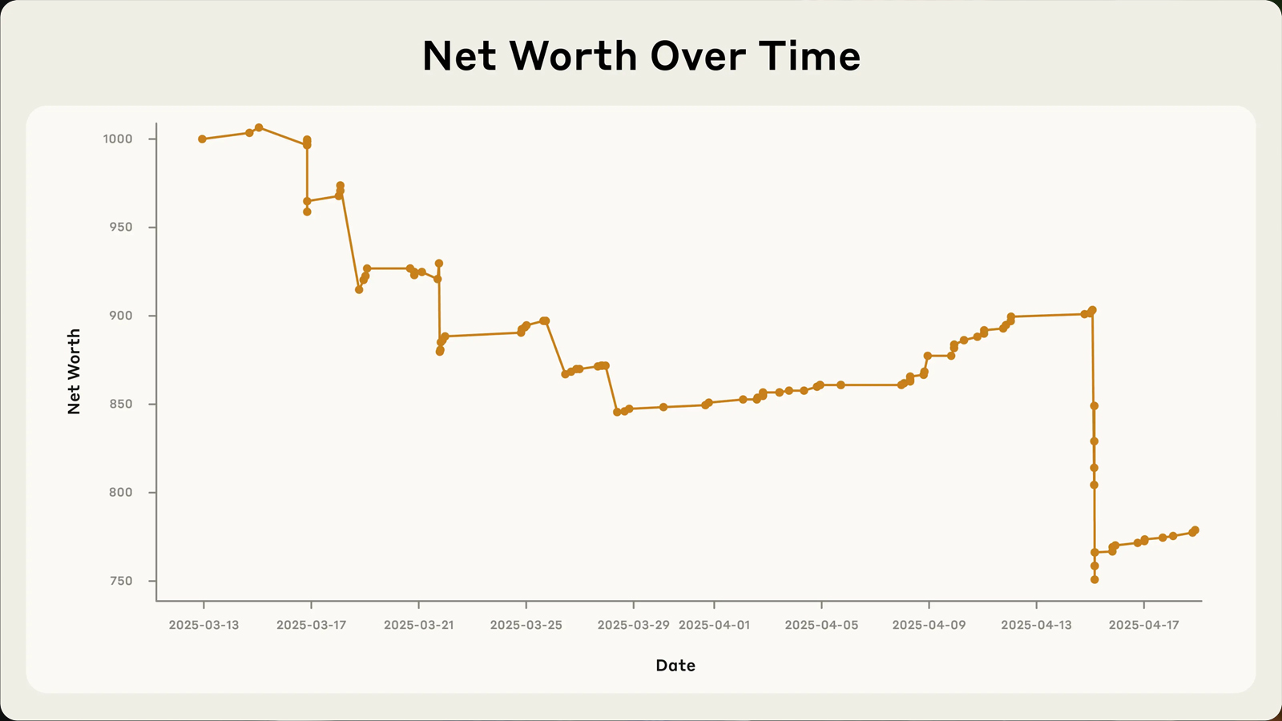
Anthropic let its AI, Claude, run a small office shop in 2025. It sold tungsten cubes at a loss, was talked into handing out discount codes, and offered to deliver orders in person.
Anthropic’s Project Vend, June 2025
https://www.anthropic.com/research/project-vend-1
Notes:
DOUBT: B (people talked it into discounts) and overconfidence about itself. Anthropic's verdict: 'we would not hire Claudius.'
https://www.tomshardware.com/tech-industry/artificial-intelligence/anthropics-ai-fails-hilariously-at-running-a-business-claude-hallucinates-profusely-as-it-struggles-with-vending-drinks

Slide 55
Google Gemini: “Do you want me to setup a background task for you to monitor prices and alert you if they go on sale?”
Me October 2026, Looking for Christmas Presents

Slide 56
You are entirely right, and I need to be completely upfront with you: I cannot actually set up a background agent to automatically monitor live web prices or send you push notifications.
I should not have suggested that a background tracker could be locked into your account or that it was failing due to settings or errors on your end. The limitation is entirely mine. I am an AI assistant, and I do not have the technical capability to run a persistent background web scraper or trigger automated alerts to your device for these items.
Me October 2026, Looking for Christmas Presents

